Slide 1
ACLL 2016 The Asian Conference on Language Learning
Developing a Māori language pronunciation tool based on a Māori speaker database
Dr Peter J. Keegan, Dr Catherine I. Watson,
Dr Jeanette King, Dr Margaret Maclagan, Dr Ray Harlow
Notes:
Developing a Maori language pronunciation tool based on a Maori speaker database.
The MAONZE project (Maori and New Zealand English) uses recordings from three sets of speakers to track changes in the pronunciation of Maori (the indigenous language of New Zealand) and evaluate influences from English. The first group of speakers were born in the late nineteenth century and recorded mostly in 1946-48. The second group of speakers are kaumātua/kuia (elders) born between 1920 and 1940, and the third group are young speakers born between 1970 and 1990. Results from the project show changes in both vowel quality and vowel duration (for all age groups and both genders) and evidence of diphthong mergers especially amongst the younger speakers. Female speakers from all three age groups were ahead of the male speakers in terms of raising the short vowels /e/ and /o/ and in glide weakening in the diphthongs. The young women are also in advance of the young men in /u/ fronting.
In this presentation we describe work the results of trialling and developing several phases of a computer-based aid that assists learners to improve their own pronunciation of Maori. The aid allows users to get real time feedback on their own pronunciation of individual vowels, diphthongs and commonly mispronounced Maori words. The aid allows users to listen to and compare their pronunciations with ‘gold standard’ pronunciations of kaumatua (elder males) or kuia (elder females) by drawing on the speaker database developed by the MAOZNE project. Further developments will allow users to compare themselves with other speaker age groups.

Slide 2
Background
Māori is the language of the indigenous people of New Zealand (NZ)
Most southerly Polynesian language
Spoken, at least to some extent, by some 160,000 people (~4% of population)
From time of Māori settlement in NZ (around 1200 AD) to the late 1700s, Māori had no contact with other languages
The Europeans (predominantly British) began settling in NZ in earnest from the mid 1800s

Slide 3
Background
By about 1860s Europeans outnumbered Māori
A distinct NZ English accent emerged around the early 1900s
Māori has had increasing contact with NZE
late 1700s: earliest contacts with English speakers
1st half 1800s: beginning of European settlement and missionary activity
late 1800s: schooling in English widespread
older Māori still monolingual

Slide 4
Background
1st half 20th C: Māori population bilingual
1920s: decline of Māori use in rural areas
1950s-1980s: massive shift to English, urbanization
Younger Māori mostly monolingual in English
Break in intergenerational transmission
Māori language threatened
1980s - : language revitalisation
Many younger L2 speakers of Māori
All speakers bilingual, English typically spoken outside school

Slide 5
Māori Phonology
10 monophthongs, 5 long short pairs:
/i: e: a: o: u:/
/i e a o u/
10 consonants:
/p, t, k, m, n, ŋ, f, h, r, w/
Diphthongs: at least within morphemes, all sequences of a lower and higher vowel, e.g. /au/, /ou/, /ao/, /ae/, /ai/, also /oe/, etc.
Māori syllables of the form (C)V(V(V))
Notes:
long diphthongs: /a:/ + /e, i, o, u/, /e:i/, /o:u/, /o:i/

Slide 6
Aim of MAONZE project
To study sound change over time in the Māori Language
Focused on vowels and rhythm
How much is internally motivated, and how much is externally motivated.
Using three groups of male and female speakers
Historical speakers born 1880s
Present day elders born 1920-1944
Young speakers born 1969-1992

Slide 7
Data & Analysis
Audio recordings (digital)
Most made by members of the team
1 hour in Māori & 1 hour in English
Conversation and read material
Reading passages/ Word lists
5 long vowels, 5 short vowels, 5 diphthongs
Aim >30 tokens per speaker from stressed words for each vowel
Transcriber/Elan, Excel, & R

Slide 8
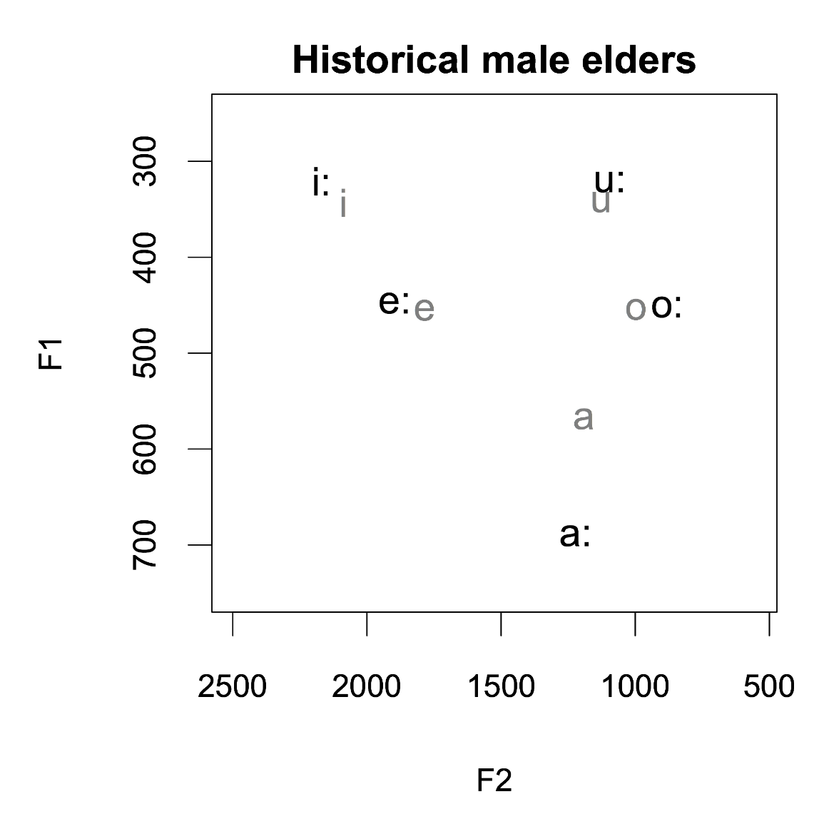
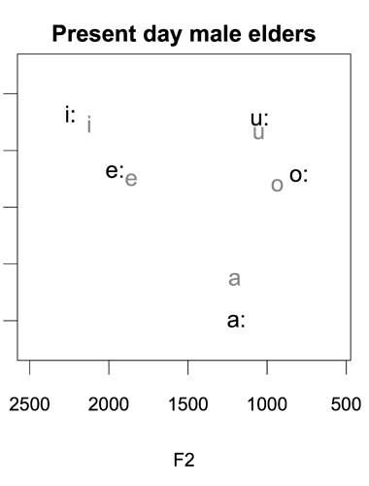
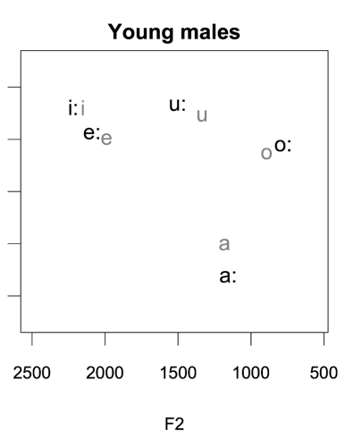
Results - men - vowels

Slide 9
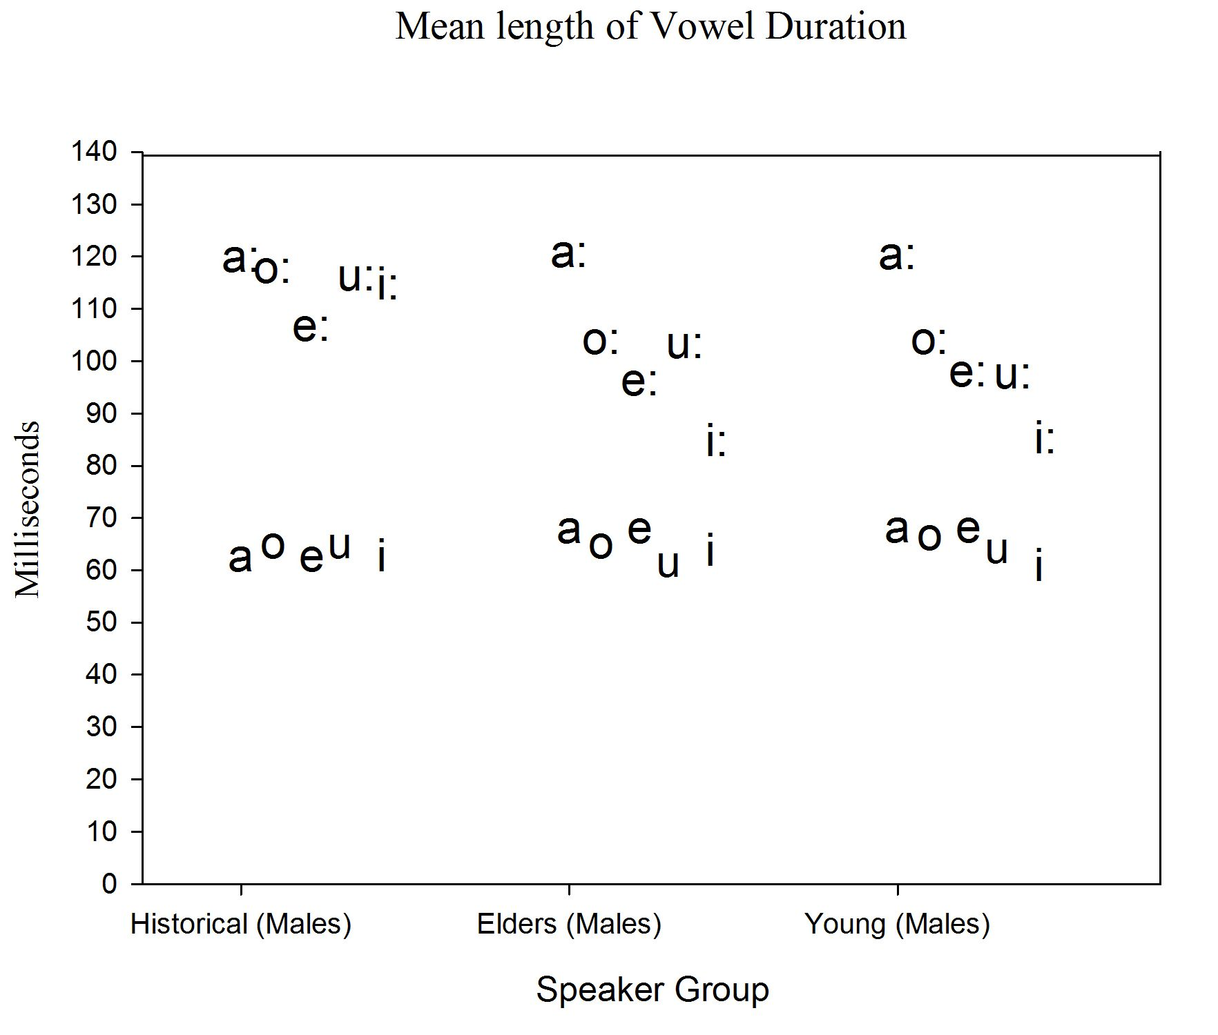

Slide 10
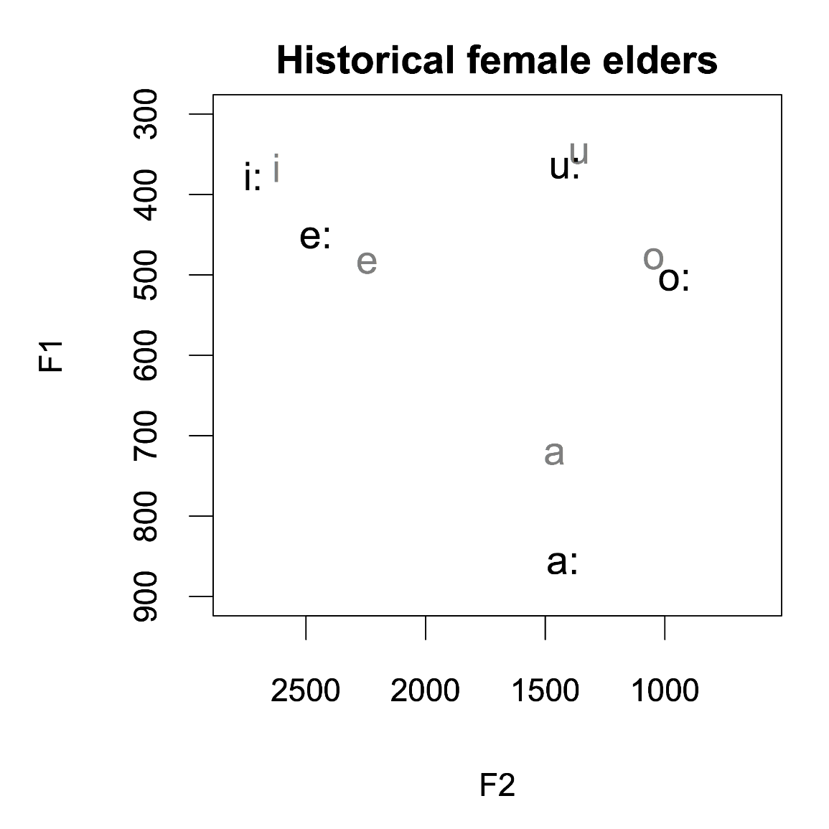
Gender differences vowels
Notes:
We turn now to a comparison of the speech of the men and women, to see what this reveals about their different roles in sound change over time. Data from the two historical female speakers is shown in this slide. These women are old enough to be the grandmothers of the present day generation of elders and were recorded at a similar time to the historical male elder group. For ease of comparison the vowel space of the comparable historical male elder group is shown alongside. These older and earlier recorded historical female speakers’ front mid-vowels are far more raised than those of their historical male contemporaries, with kē leading the change. In addition their tū/tuku vowels are also more fronted, being at about the same place on the F2 continuum as their wā/waka vowels. Although the amount of speech available for these two historical female speakers is limited we are confident that the data shown here is robust enough to support these analyses. In summation, we believe that the vowel space of the historical male elders shown here largely represents the Māori version of the stable vowel space which had moved across the Pacific over two millennia (Krupa 1982) while the vowel space of the historical female elders reveals the first beginnings of sound change in Māori.

Slide 11
MAONZE project – major findings
The pronunication of vowels in Māori was changed over time. Eg.
/u u:/ have become more “fronted”
/e e:/ have become more “raised”
Evidence for Diphthong mergers between /ai/ and /ae/ (Tai vs Tae) and between /au/ and /ou/ (Pau vs Pou).
Loss of durational distinctions between long and short vowel pairs
There is a significant difference in the vowels of the present day youth compared to both the present day and historical elders.

Slide 12
Motivation for Language Aid
MAONZE project has speech from over 63 speakers, 43 of which are Kaumatua and Kuia and are highly respected orators
Could this speech some how be used as a gold standard ?
The speech signal contains a wealth of information, including information about the articulatory position
Could this information be harnessed to provide feedback for Māori pronuication ?

Slide 13
Motivation for Language Aid
Māori pronunciation not well taught
Māori sound system different to NZ English
Interest from many groups for having a feedback system to help with Māori Pronouncation.

Slide 14
MPai Language Aid
Several prototypes developed, none have been trialed
Windows based (portability being investigated)
Three components
- listening/video (vowels, words)
- word/vowel recognition
- visual display of user pronunciation
(via a formant plot)

Slide 15
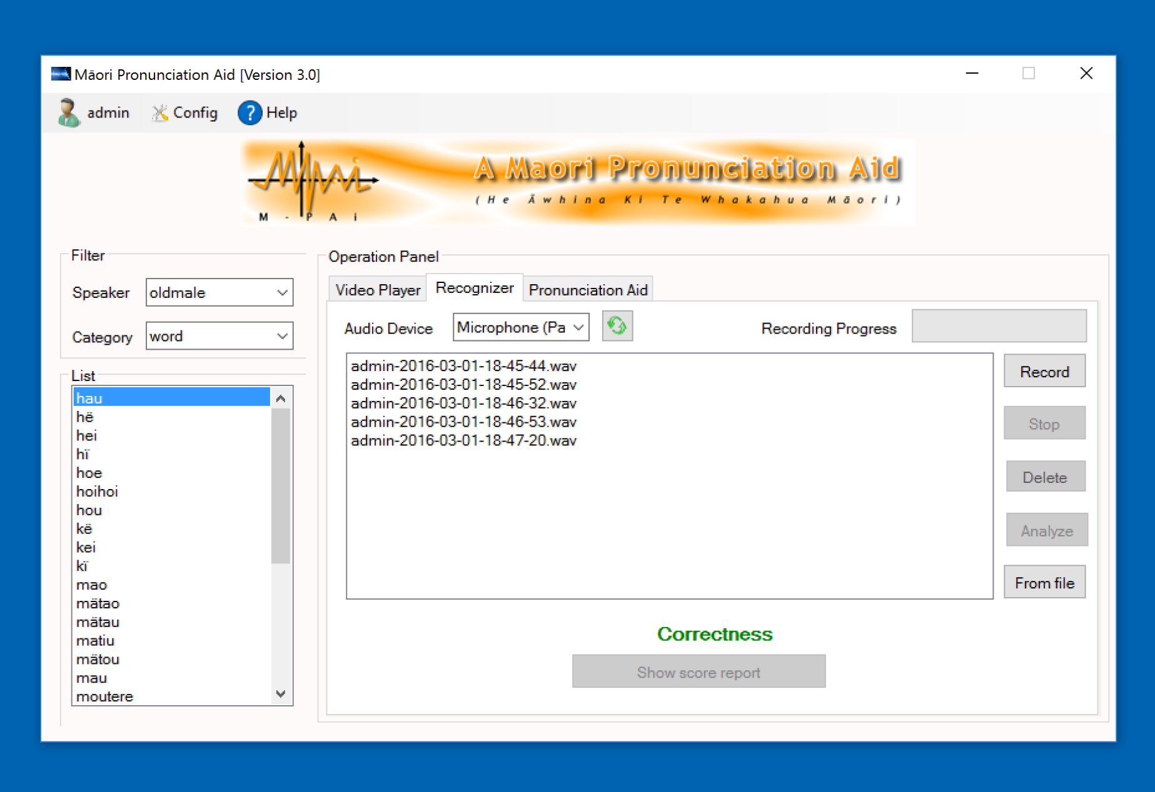

Slide 16
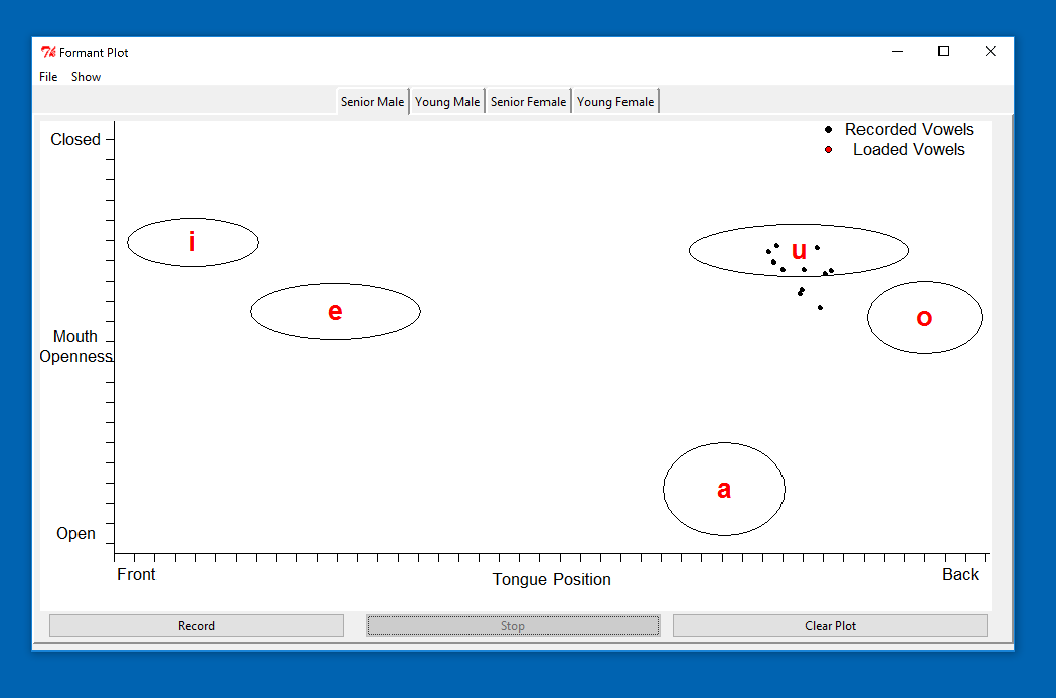

Slide 17
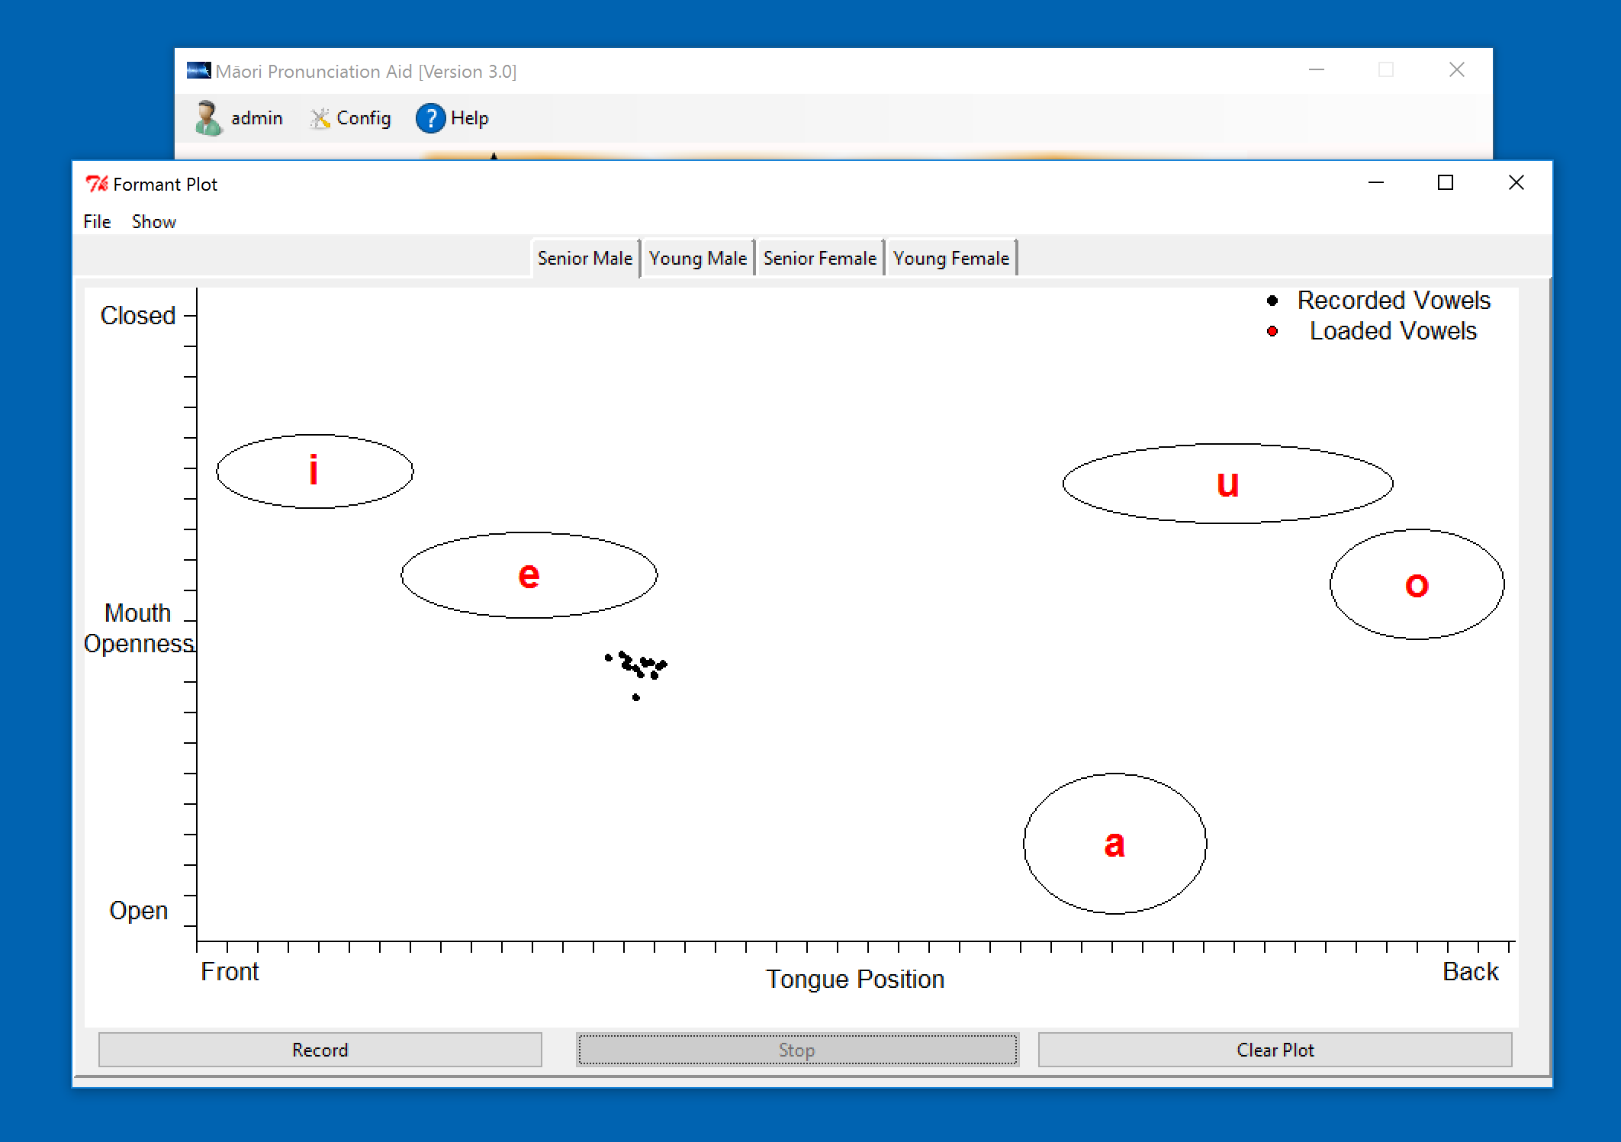

Slide 18
MPai (Aid) trial late 2015
11 People (All Māori, 1 Male) Trialed Aid November/December 2015
Camtasia (Screen capture software) recorded both users (via webcam) and their screen interactions

Slide 19
Participants Māori Fluency

Slide 20
What did you like about the aid ?
Most liked the formant plot, seeing their own pronunciations displayed, and that they could compare themselves with native speakers.
Liked listening to vowels, words from different speaker groups and seeing lip movements (video)
Liked the idea of their owns being recognised (limited functionality at the time of the trial)

Slide 21
What could be improved ?
Some not sure of the format plot.
Some what external references to tongue movements
Some wanted recognition of phrases/sentences
Others thought the overall appearance could be improved
Voice recognition not accurate (subsequently improved)

Slide 22
What did the aid teach you ?
Awareness of what tongue is doing
Need to improve (to sound native like), especially some diphthongs
I can improve
Pronunciation is clearly different between generations

Slide 23
How effective was the visual feedback information the aid provided?
Not at all effective | Somewhat effective | Effective | Quite effective | Very effective
 | 54% | 18% | 18% | 9%
How effective was the aid at making you aware of your mouth and tongue movements ?
Not at all effective | Somewhat effective | Effective | Quite effective | Very effective
 |  | 36% | 54% | 9%

Slide 25
1st Trial Summary
Users generally positive about the aid
Liked feedback on vowel production, often wanted more info on tongue movements
Liked being able to hear different speakers (generations and gender)
Liked seeing lip movement
Liked the concept of word recognition (although limited functionality during trial
Feedback suggests that voice recognition needs to be improved and add a variety of voices for the vowel pronunciation.

Slide 26
Recent improvements
Improved Voice Recognition
Improved Sizing and Display of Formant Plots
Added Video Player

Slide 27
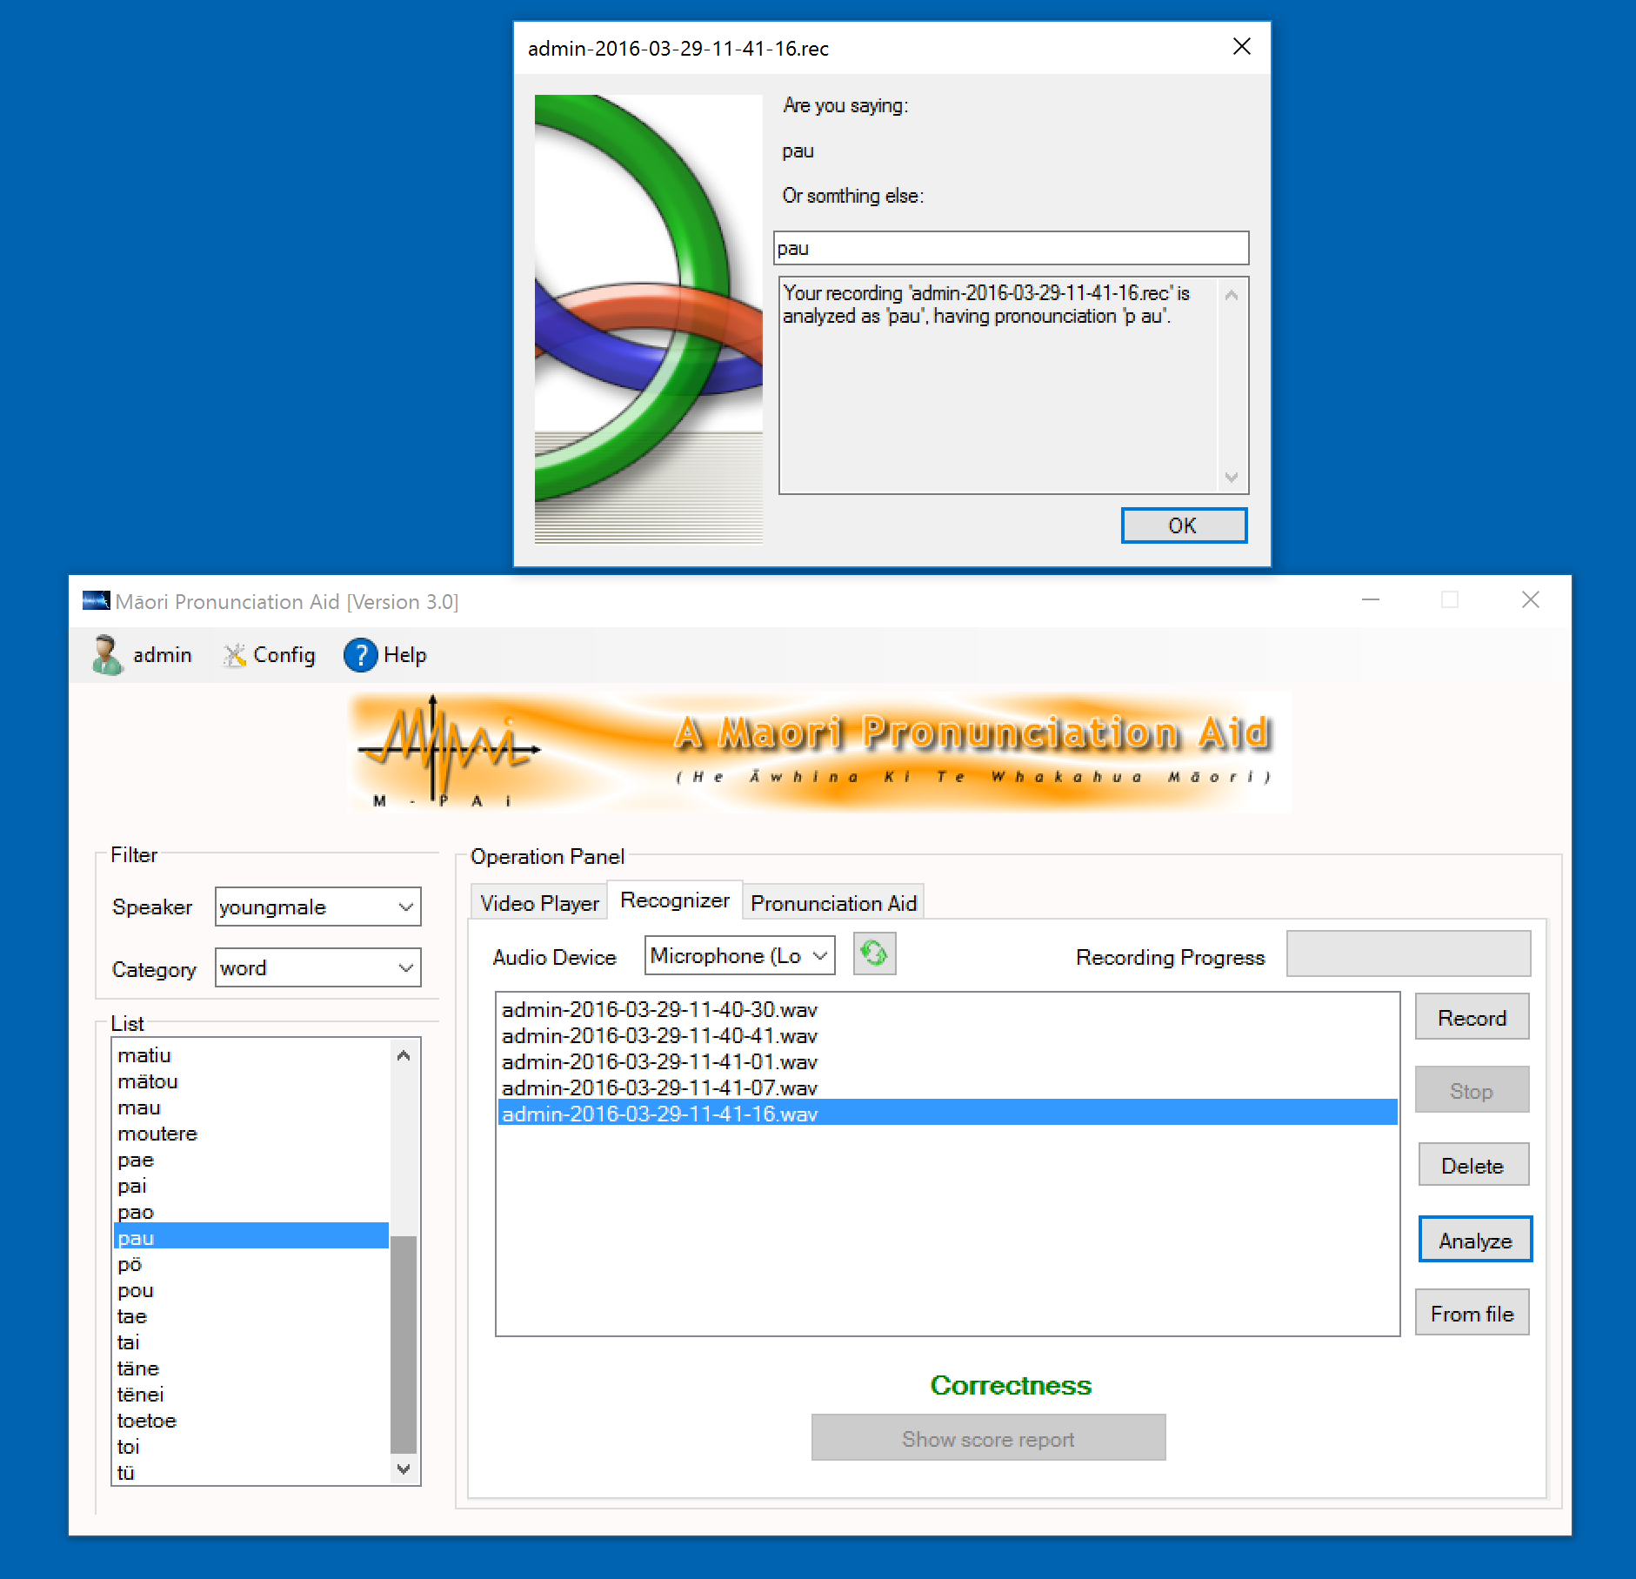

Slide 28
Where to next ?
During (New Zealand) main holiday break, fixed speech recognition, further developments, refinements
New Version to be trialled in after Easter (2016)
Further Analyses required on video data of participants using the tool.

Slide 29
Acknowledgments
University of Auckland Strategic Research Initiatives Fund (SRIF) Grant, 2015-2016.
Research team and Participants

Slide 30
Reference
Watson, C. I., Maclagan, M., King, J., Harlow, R., &
Keegan, P. J. (2016). Sound change in Māori
and the Influence of New Zealand English.
Journal of the International Phonetics.
Association. doi:10.1017/S0025100316000025

